Slide 1
A Publishers Perspective on Serials in Changing Times
Patricia Hudson
Associate Director of Institutional Marketing
Online Products
Oxford University Press
Notes:
Interesting timing for me as I’m moving from nearly 15 years in journals publishing to working across our online products.

Slide 2
About OUP
A few things you might not know
OUP is a department of the University of Oxford
Largest university press worldwide
55 global offices including Cary, NC
100+ years of Journals publishing experience
Established in 1586 by decree from the Star Chamber

Slide 3
When I started marketing journals….
First and foremost a print product
Online was free with print subscription
Different journals on different platforms
Issues posted online after being mailed
Everyone had a copy of our price list and our circulation numbers at their desk
Our marketing was primarily direct mail with a tear off subscription form
Discoverability a clear second to circulation
My favorite search engine was WebCrawler

Slide 4
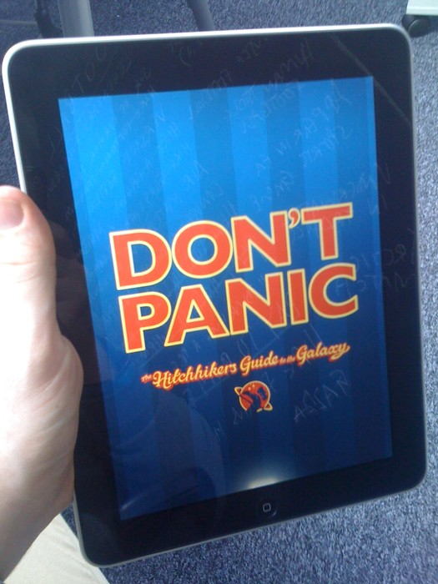
Marketing Journals today
Online publication is publication
Publish ahead of print is the norm
Questions about need for an “issue”
Juggle shifting and multiple business models
What is circulation?
Marketing is electronic and ideally a service
Discoverability and usage are the engine of a healthy journal and our primary marketing goal
Blurring of lines between journals and other online products

Slide 5
What is the Oxford Index?
A Search and Discovery Gateway
A free discovery service, the Oxford Index is designed to help users begin their research by providing a single, convenient search portal for trusted scholarship from Oxford and our partners, and then direct them to the most relevant related materials—from journal articles to scholarly monographs and more.

Slide 6
What is the Oxford Index?
A Search and Discovery Gateway
A standardized description of every piece of Oxford content, in one place
A free, single search portal for OUP and partner content
“Index Cards” for every piece of OUP content; quick pathways to full text
Searchable from the web; cross-searchable across Oxford products
What are Index Cards?
The Oxford Index contains a cross-searchable set of hundreds of thousands of free “index cards,” each representing a single article, chapter, journal or book.
Index cards display key information—including abstracts and keywords—about a work, helping users judge its relevance to their research before following links into the full-text.

Slide 7
About Oxford Index Beta
A Search and Discovery Gateway
The Oxford Index searches:
• University Press Scholarship Online—
a collection of academic monographs from
leading university presses worldwide, including more than 80,000 chapters from 7,200 titles
• Oxford Handbooks Online—over 3,400 chapters from 100+ titles
• A collection of more than 150,000 recent articles from 235 Oxford Journals
Coming in April:
Oxford Islamic Studies Online
Oxford Biblical Studies Online
American National Biography Online
Who’s Who & Who was Who
Oxford Reference Online
Oxford Dictionary of National Biography
British Academy Publications Online
Oxford Journals [1996-2005]
Coming in May:
Oxford African American Studies Center
Oxford Bibliographies Online
Oxford Medicine Online
Coming Summer/Fall 2012:
Oxford Handbooks Online II / Oxford Research Reviews
Oxford Law Online
Oxford Scholarly Editions Online

Slide 8
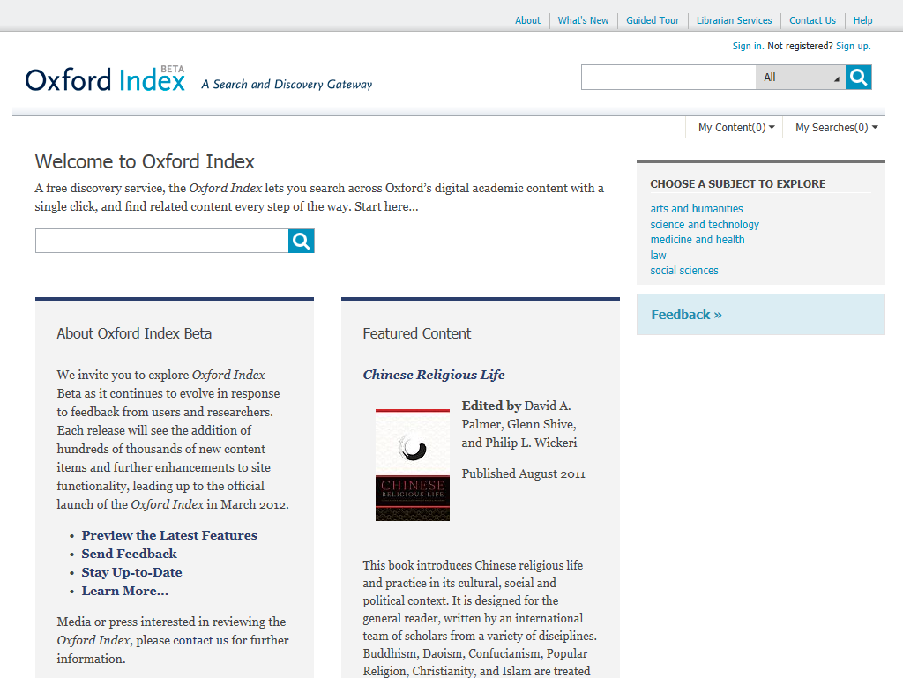
Developed in direct response to user feedback, the homepage allows researchers to quickly begin exploring the more 250,000 Index Cards via either search or browse

Slide 9
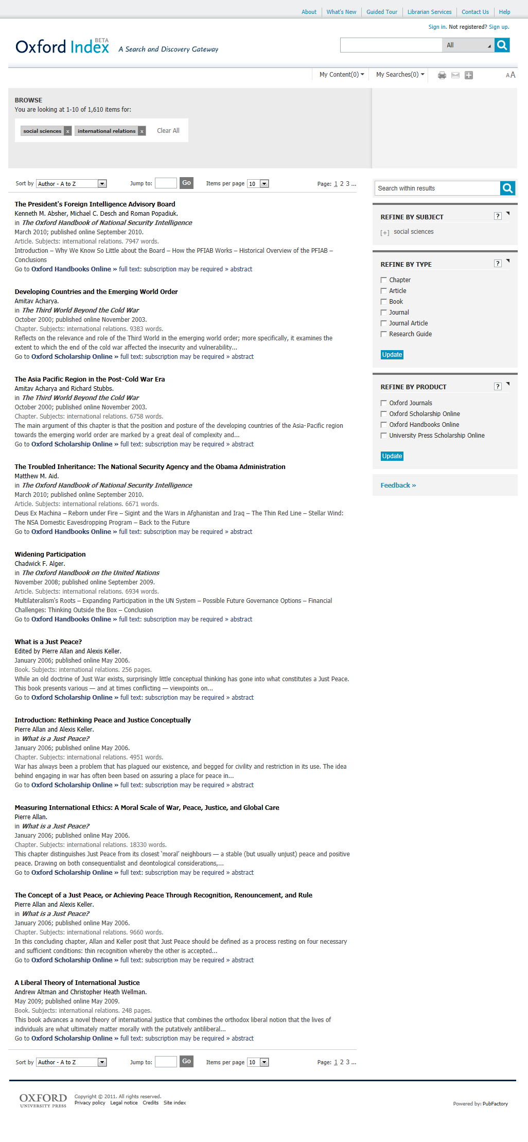
Filters and search terms are clearly displayed and easily adjusted
Results display key bibliographic information and a preview of content, in addition to links directly to full-text
Refine your results by subject, content type, or product. Coming in April – filter by full-text access

Slide 10
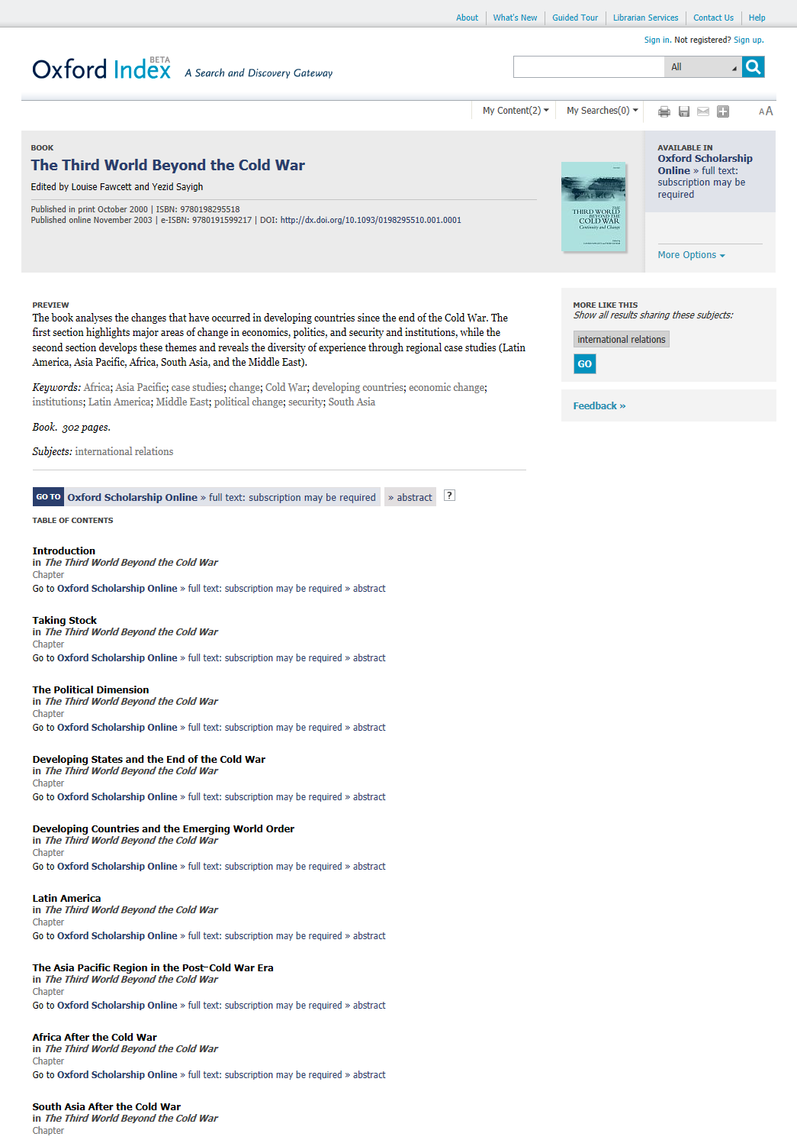
Key bibliographic information, including abstracts and keywords, is provided
for each for each item of content
Multiple links effortlessly drive users directly
into full-text content.
Coming in April—
institution-specific indication of access rights.

Slide 11
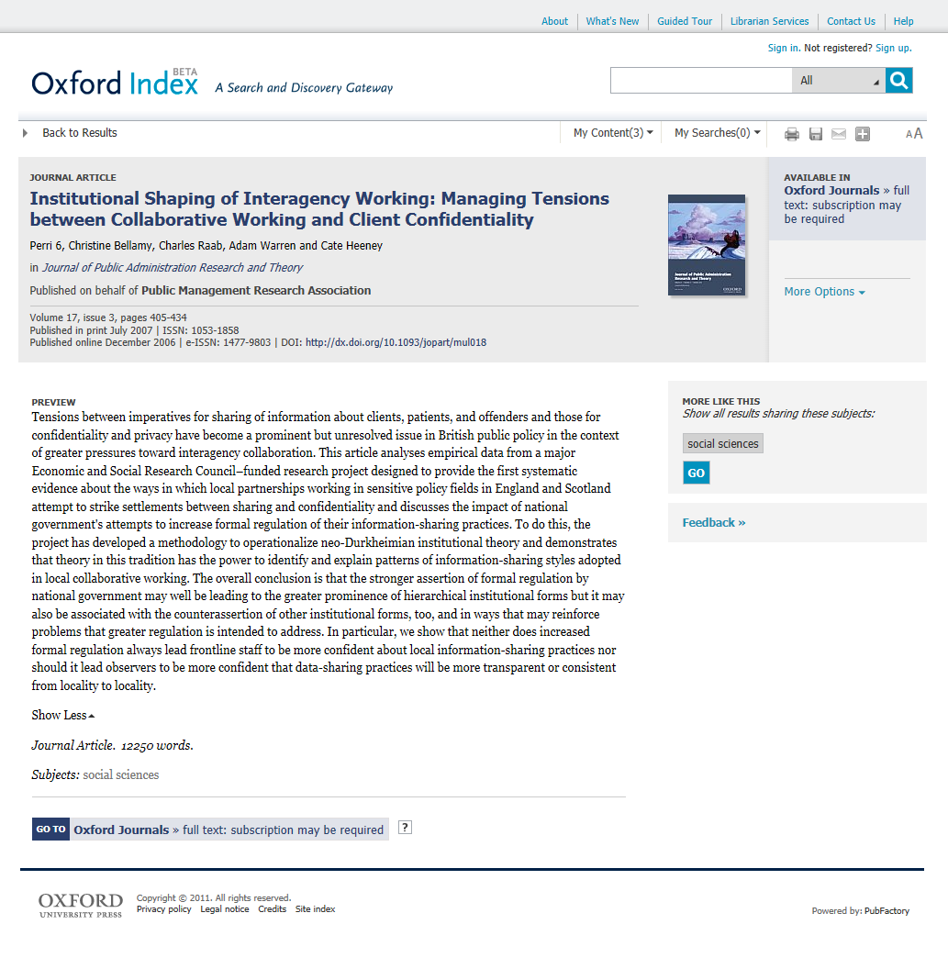
Free preview of content and editorially assigned
keywords enable users to
assess relevance at a glance.
Easily discover related content based on subject.
Coming in April—
expansion of related content links to help further guide research

Slide 12
Oxford Index
Additional Functionality Coming Soon
April/May 2012:
Passive authentication into your OUP account will allow the OI to identify your subscriptions and purchased content
Filter results by full-text availability
Library branding
OpenURL
Wired to the library: Search your local library’s holdings directly from the Index
Smart, integrated linking across products: Oxford Index underbar rollout begins
May/June 2012:
Overview Pages – at-a-glance topic pages providing a guide through scholarship on a given subject or person
Integration with existing products: Receive recommendations on related content; search the full Index from within UPSO, etc.
Mobile-optimization
Geo-location to help users quickly find their local library

Slide 13
The Future of Serials
Some things haven’t really changed
Scholarly research is more available and discoverable than it has ever been.
Librarians and publishers are more necessary than ever to help researchers get to the right information.

